Slide 1
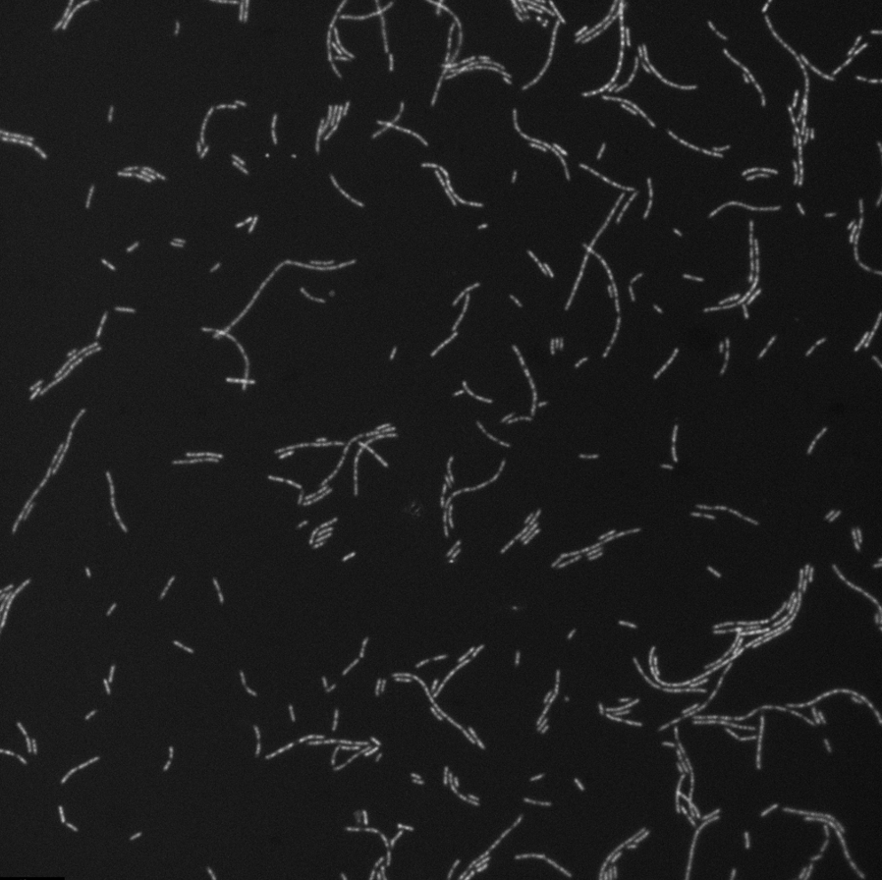

Exploring the Dynamics of Cell Morphology and Organic Carbon Concentration
Kadin Pulliam, Emma Brown, and Elizabeth Trembath-Reichert
Arizona State University

Slide 2
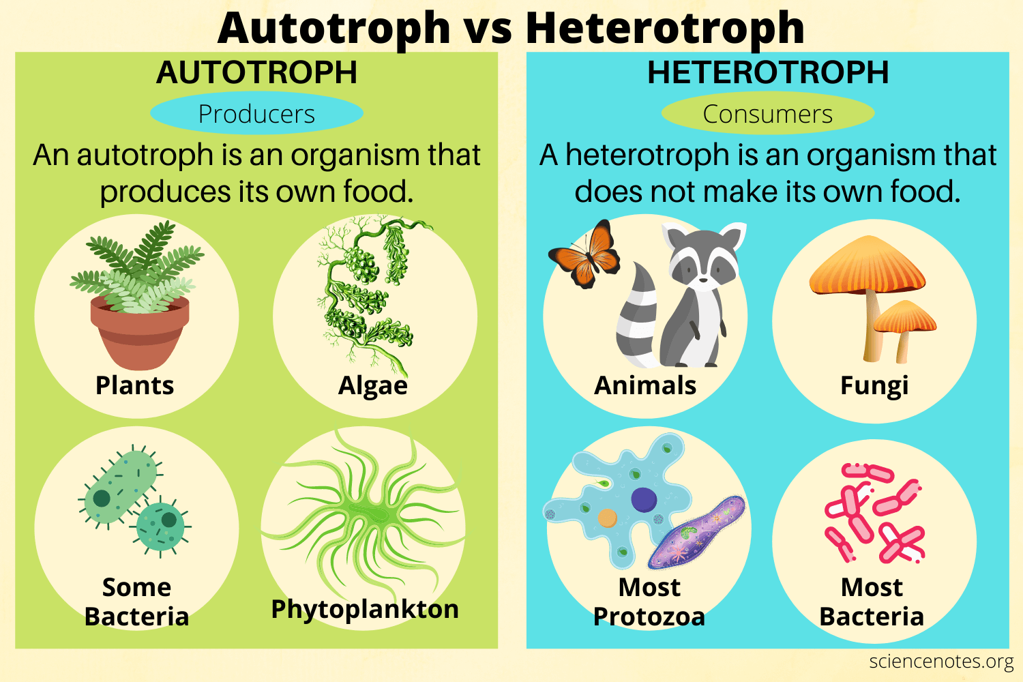
Some Background Info
Two science questions my project relates to:
Is it possible for heterotrophs to fix inorganic carbon?
If so, does their environment influence this?

Slide 3
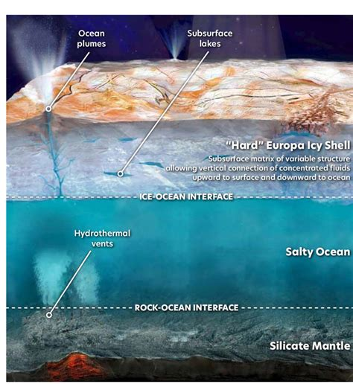
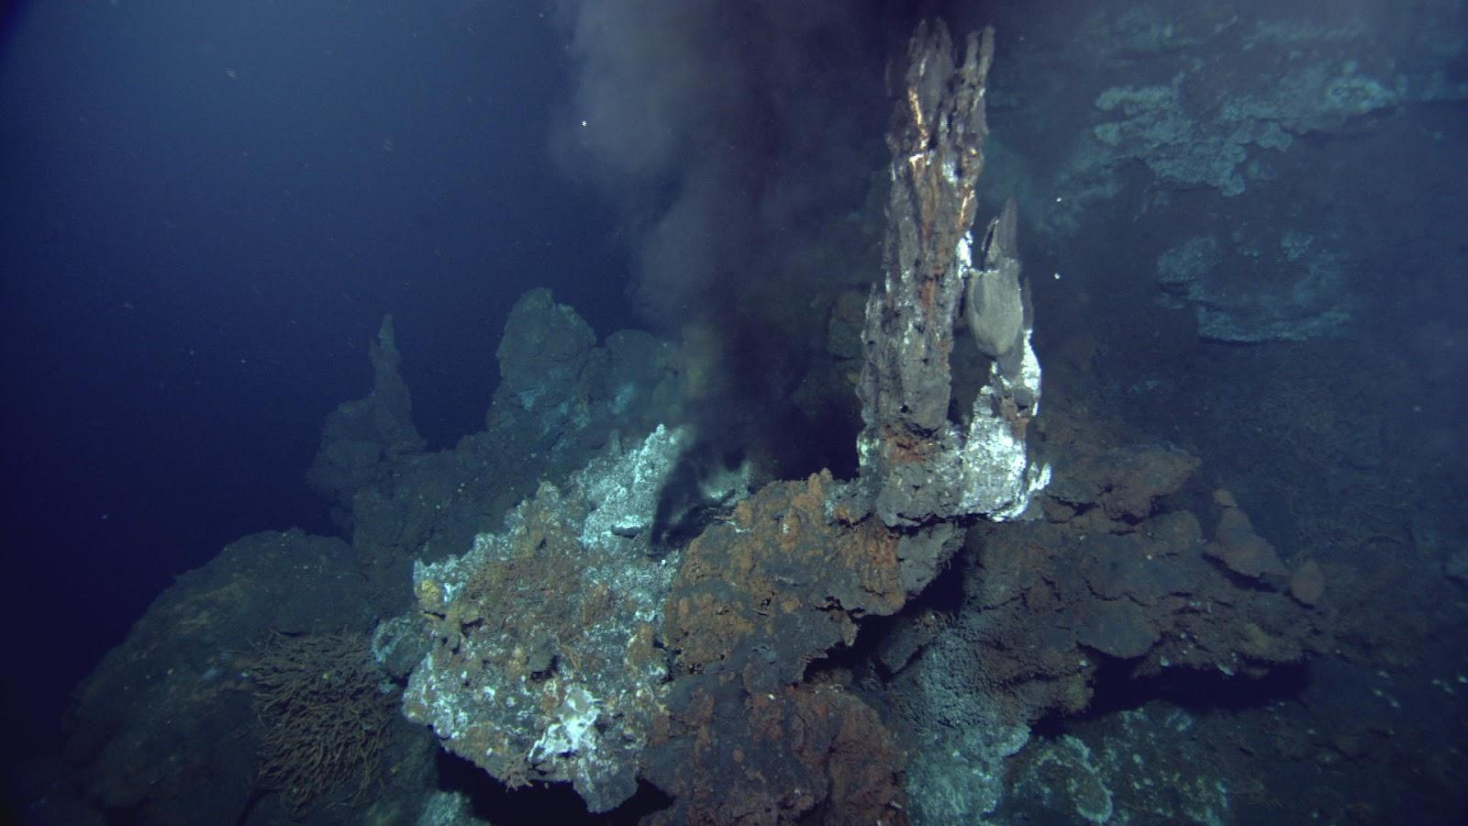
Why is this Important?
Understanding how an environment influences microbial life is key to deriving how life might exist in similar environments on other planetary bodies.
Notes:
If asked about other things this is important to like carbon cycle, you can talk about how for your own interests this is the big thing. But this research does impact other things like the carbon cycle.

Slide 4
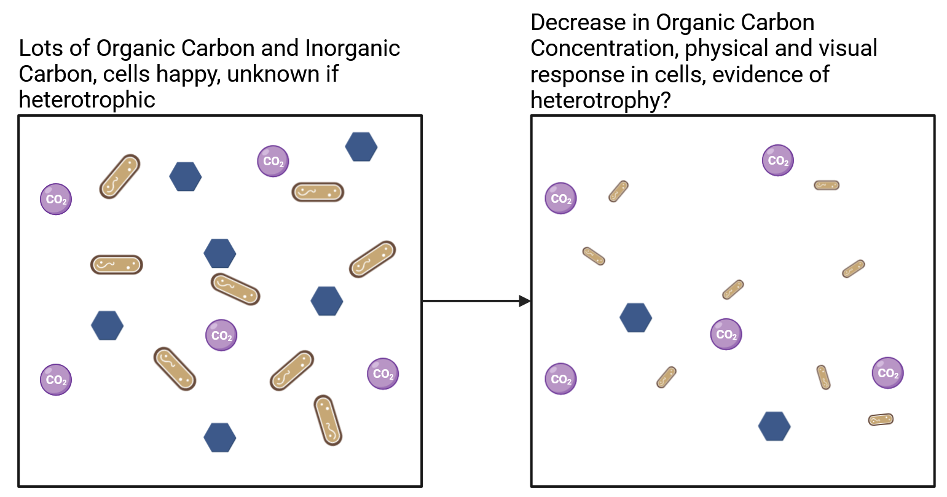
How does my Research relate to this?
My project investigates the physical response in microbes to changes in their environmental conditions.
Notes:
If someone asks about change in cell size, you can add in that it's vital to the overall research project to detect if the cells are "stressed". Optical density can tell us this, but your cell size change data is a novel aspect of adding to that point!

Slide 5
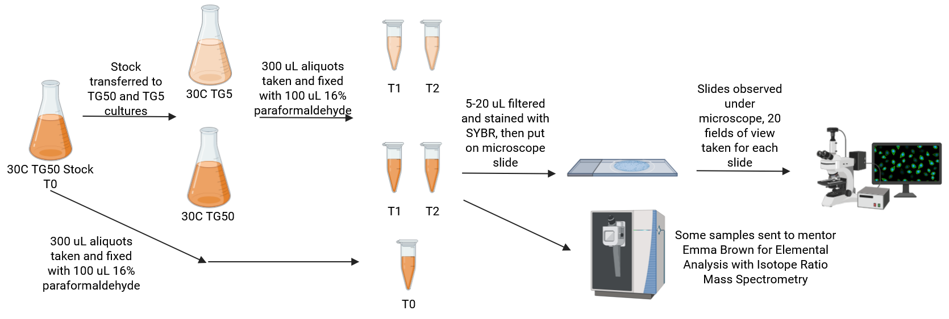
Methods - Sample collection and Microscope Imaging
For this experiment, I used the mesophilic soil bacteria Pseudomonas putida.

Slide 6
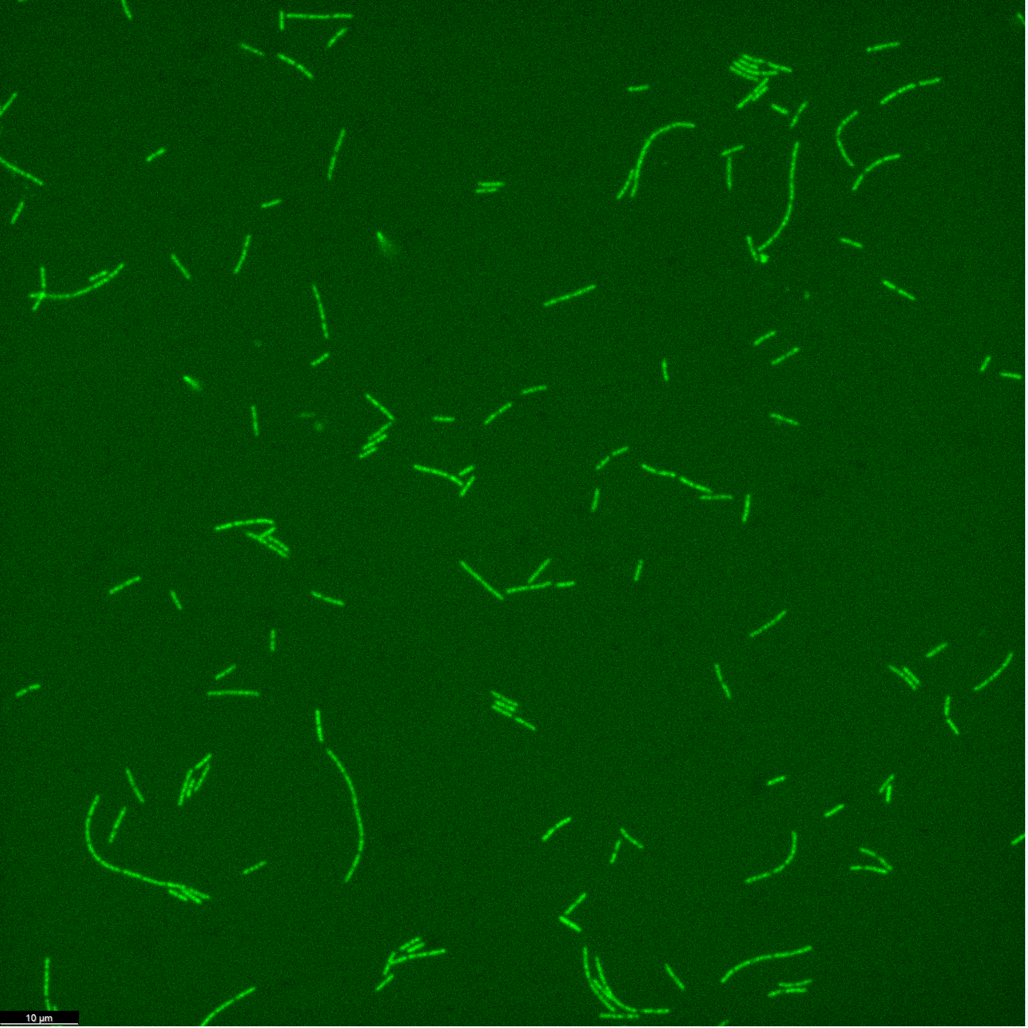
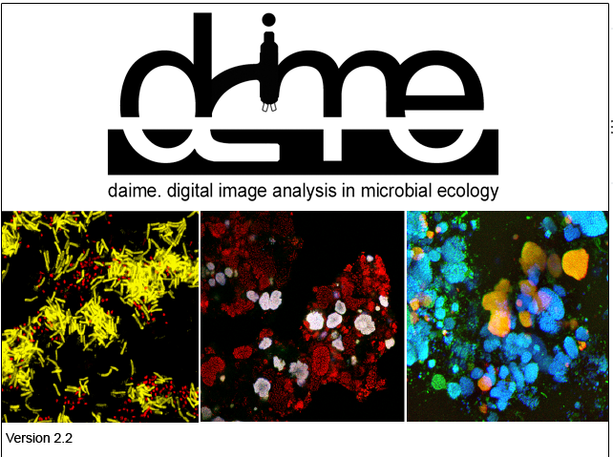
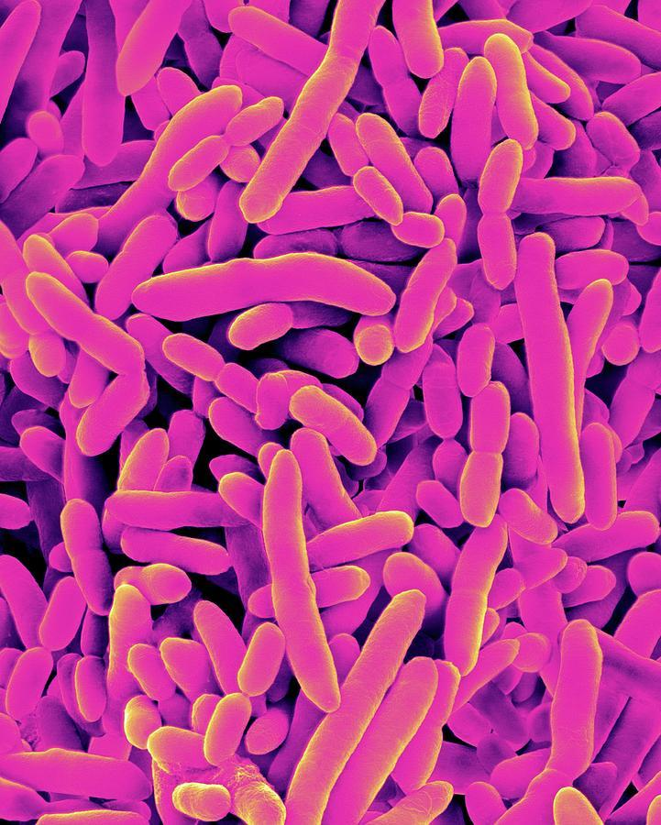
Methods - Intro to DAIME
DAIME is an image analysis and visualization software designed for microbiology.
Can be used to visualize microscope images, process them to clear up noise, count the number of cells in each image, and measure cells.
  Very useful!

Slide 7
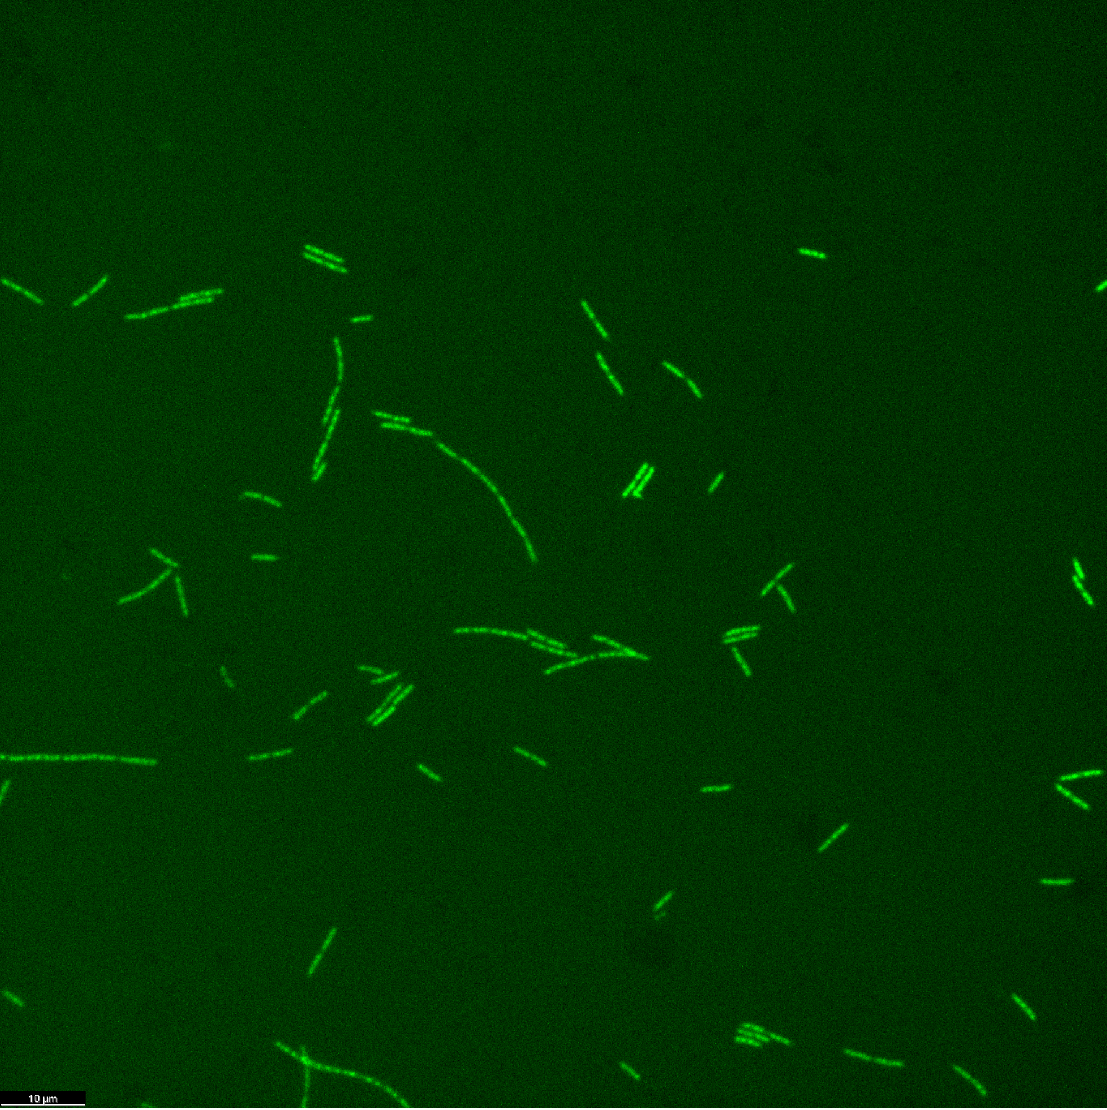
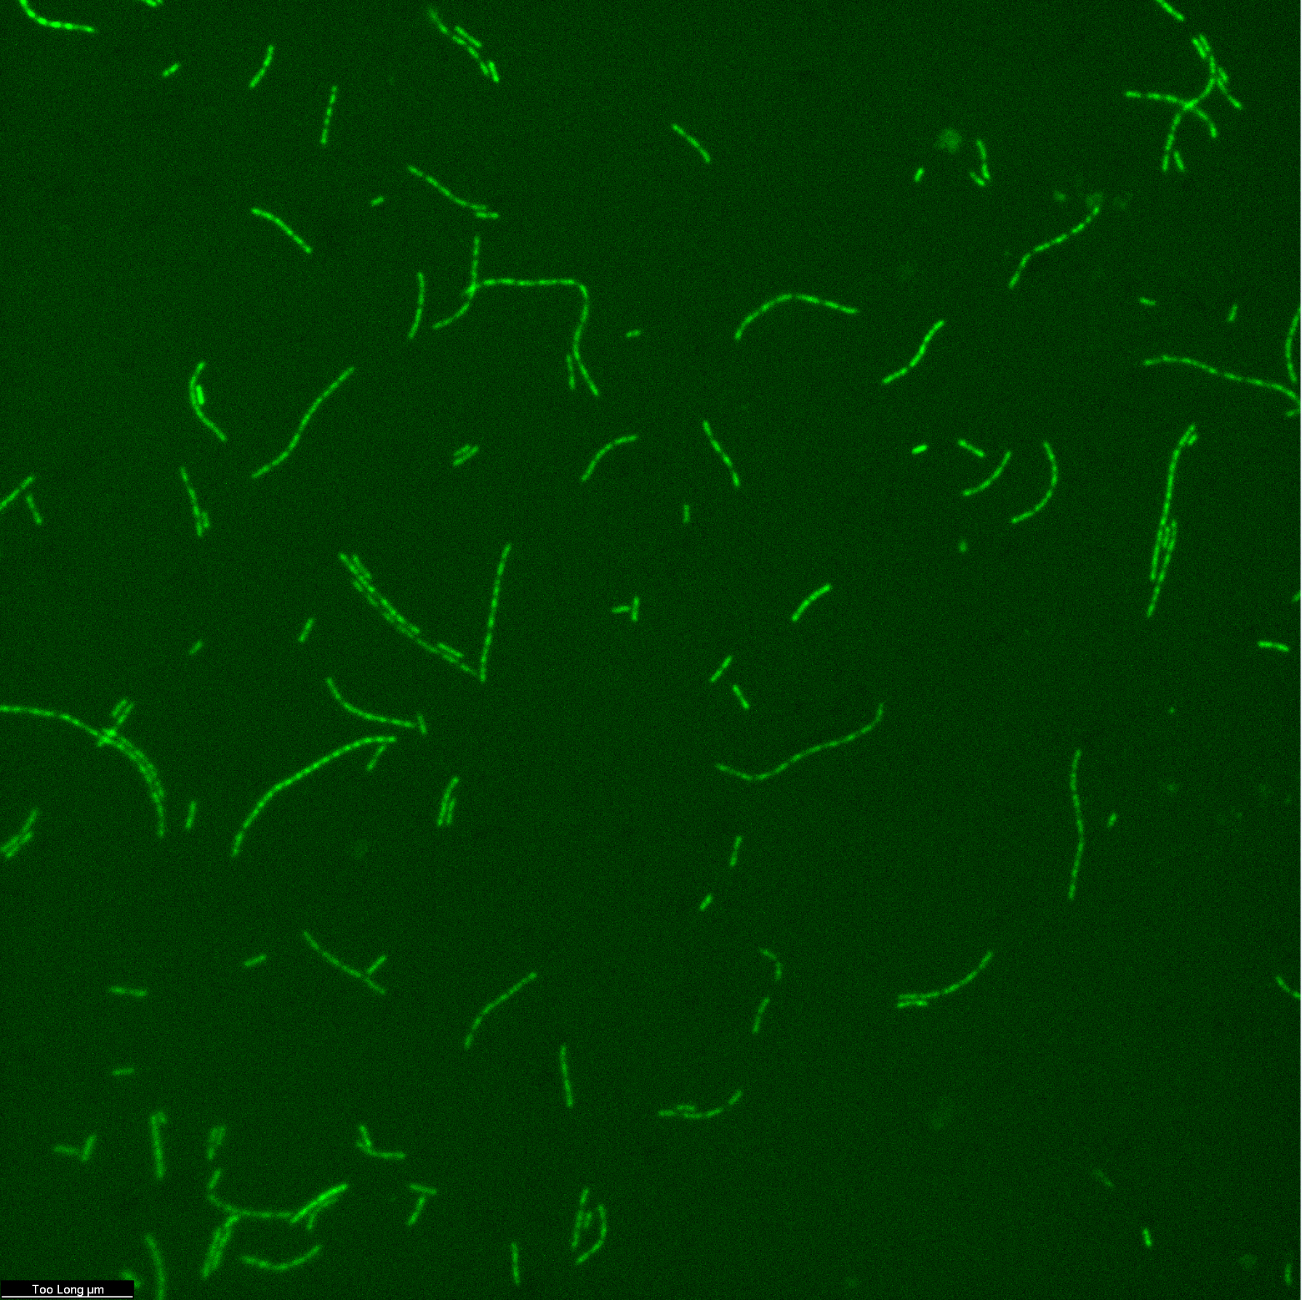
Visual Results - 30C Carbon Ideal
Percent Enrichment of 13C bicarbonate: 0.25%
30C Ideal Early Growth Phase
30C Ideal Late Growth Phase
Notes:
We see that the cells at T2 are much smaller than they were at T0 and T1

Slide 8
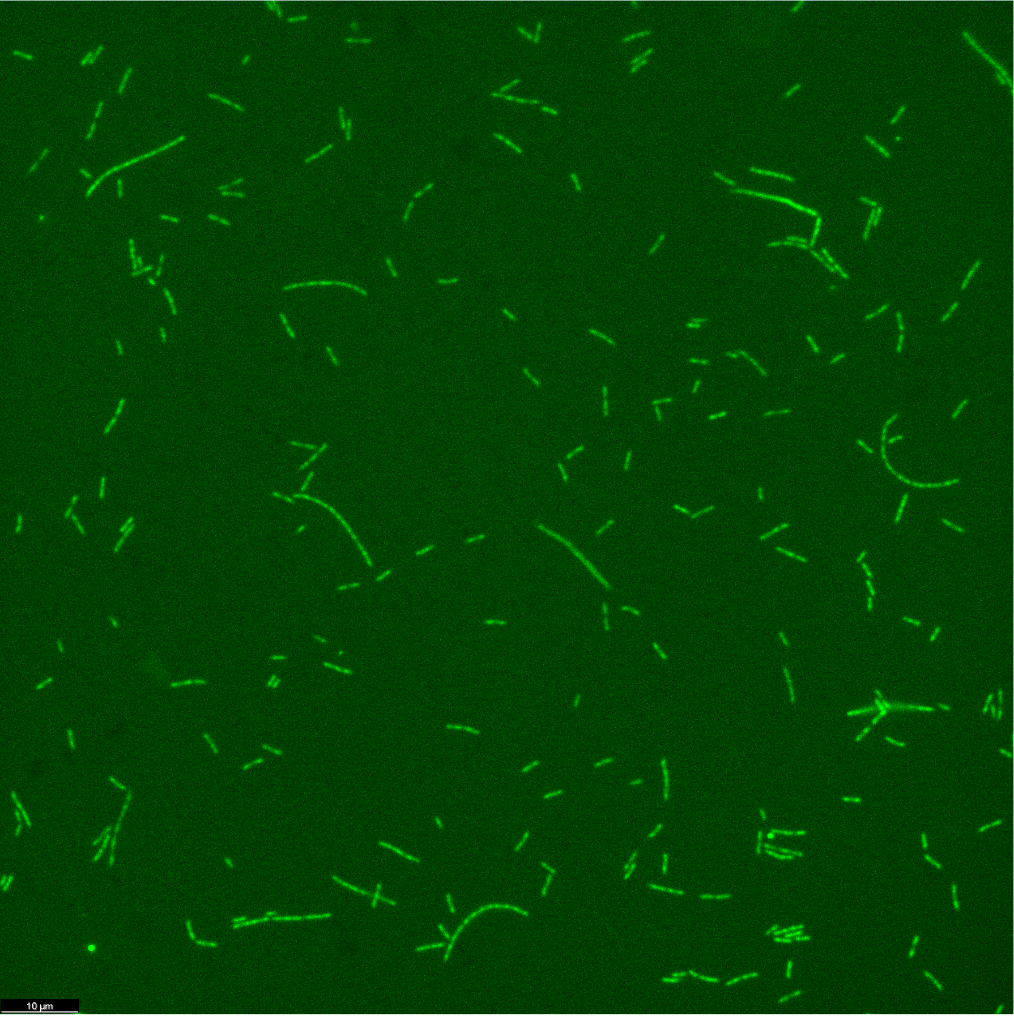
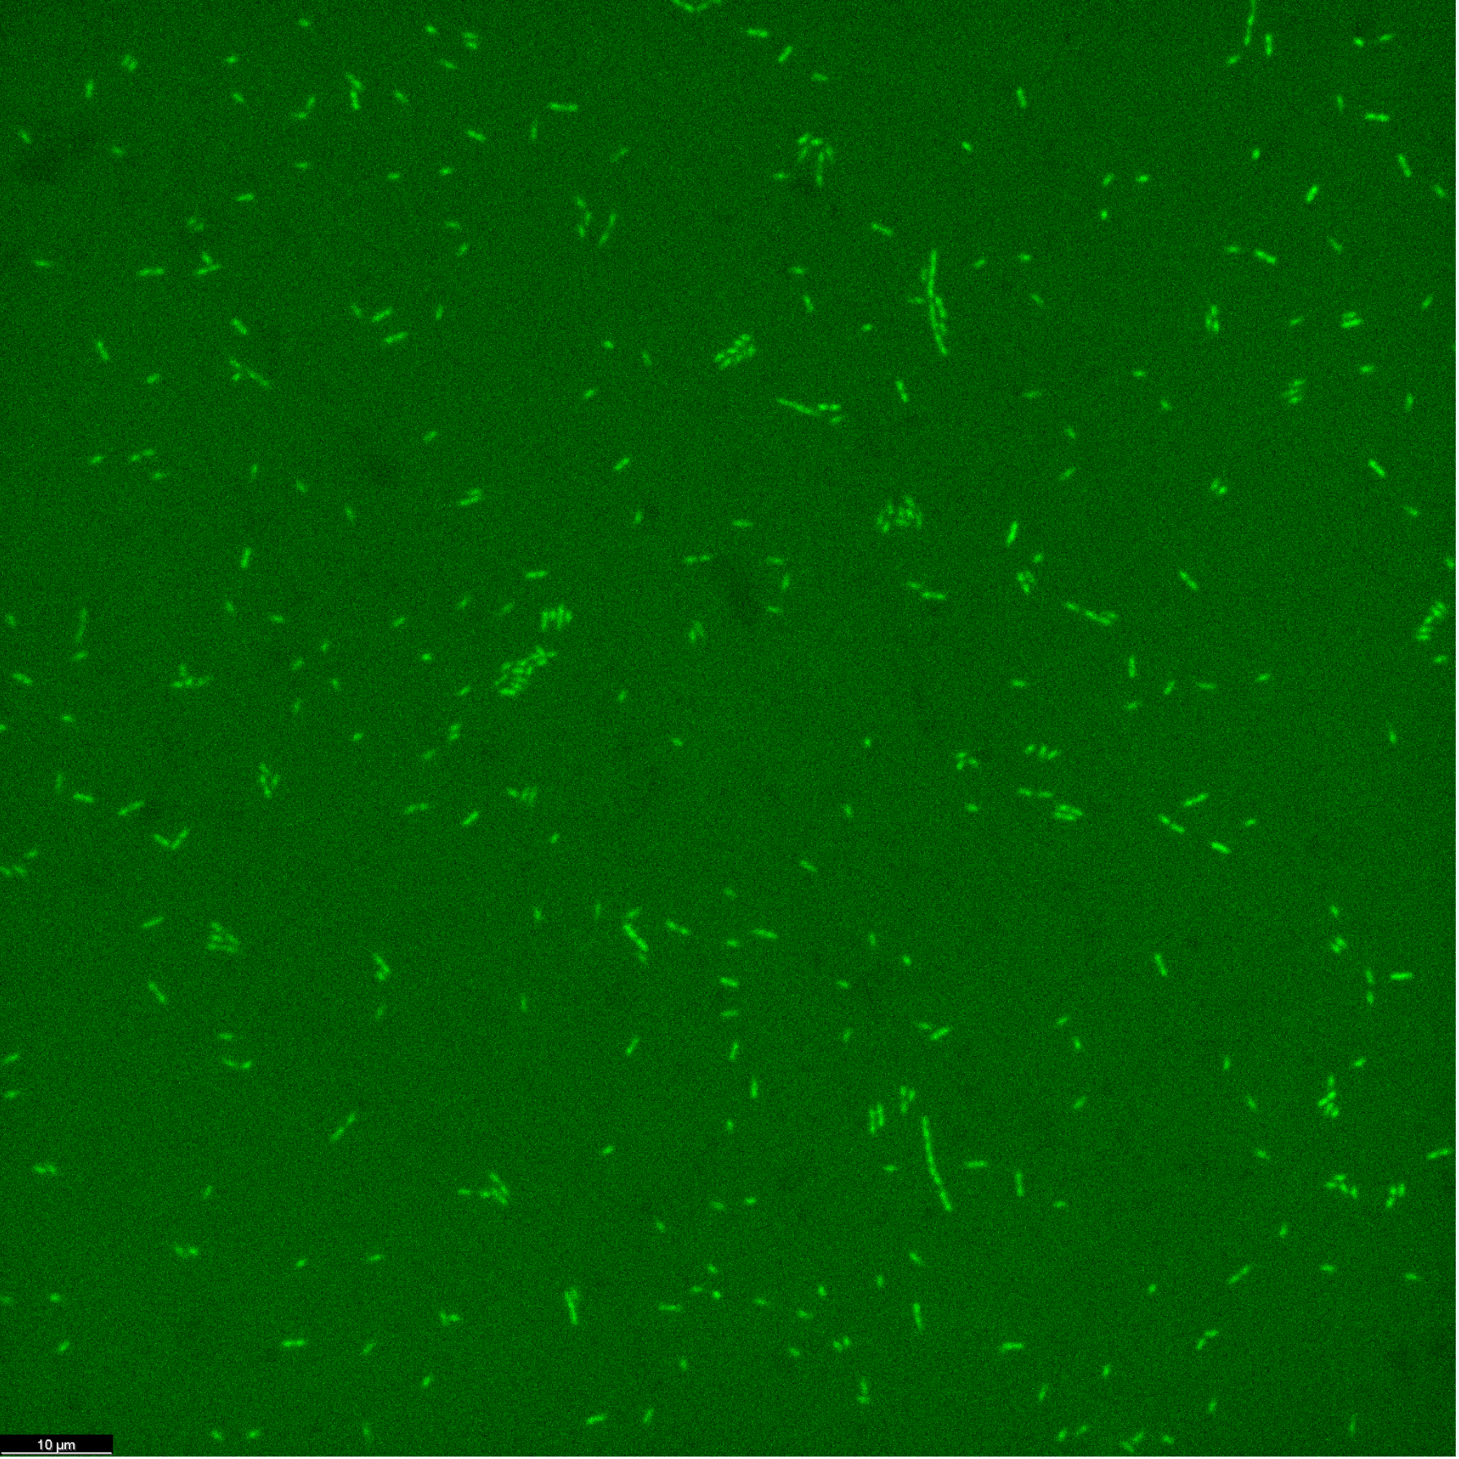
Visual Results - 30C Carbon Limited
Percent Enrichment of 13C bicarbonate: 1.12%
30C Limited Early Growth Phase
30C Limited Late Growth Phase
Notes:
We see that the cells at T2 are much smaller than they were at T0 and T1

Slide 9
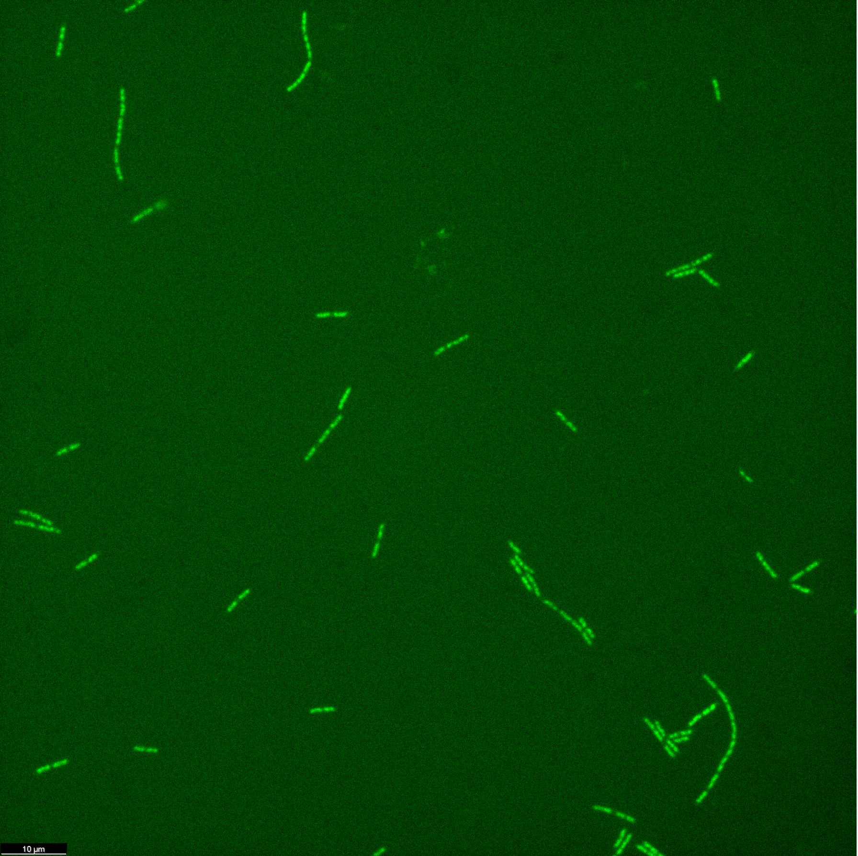
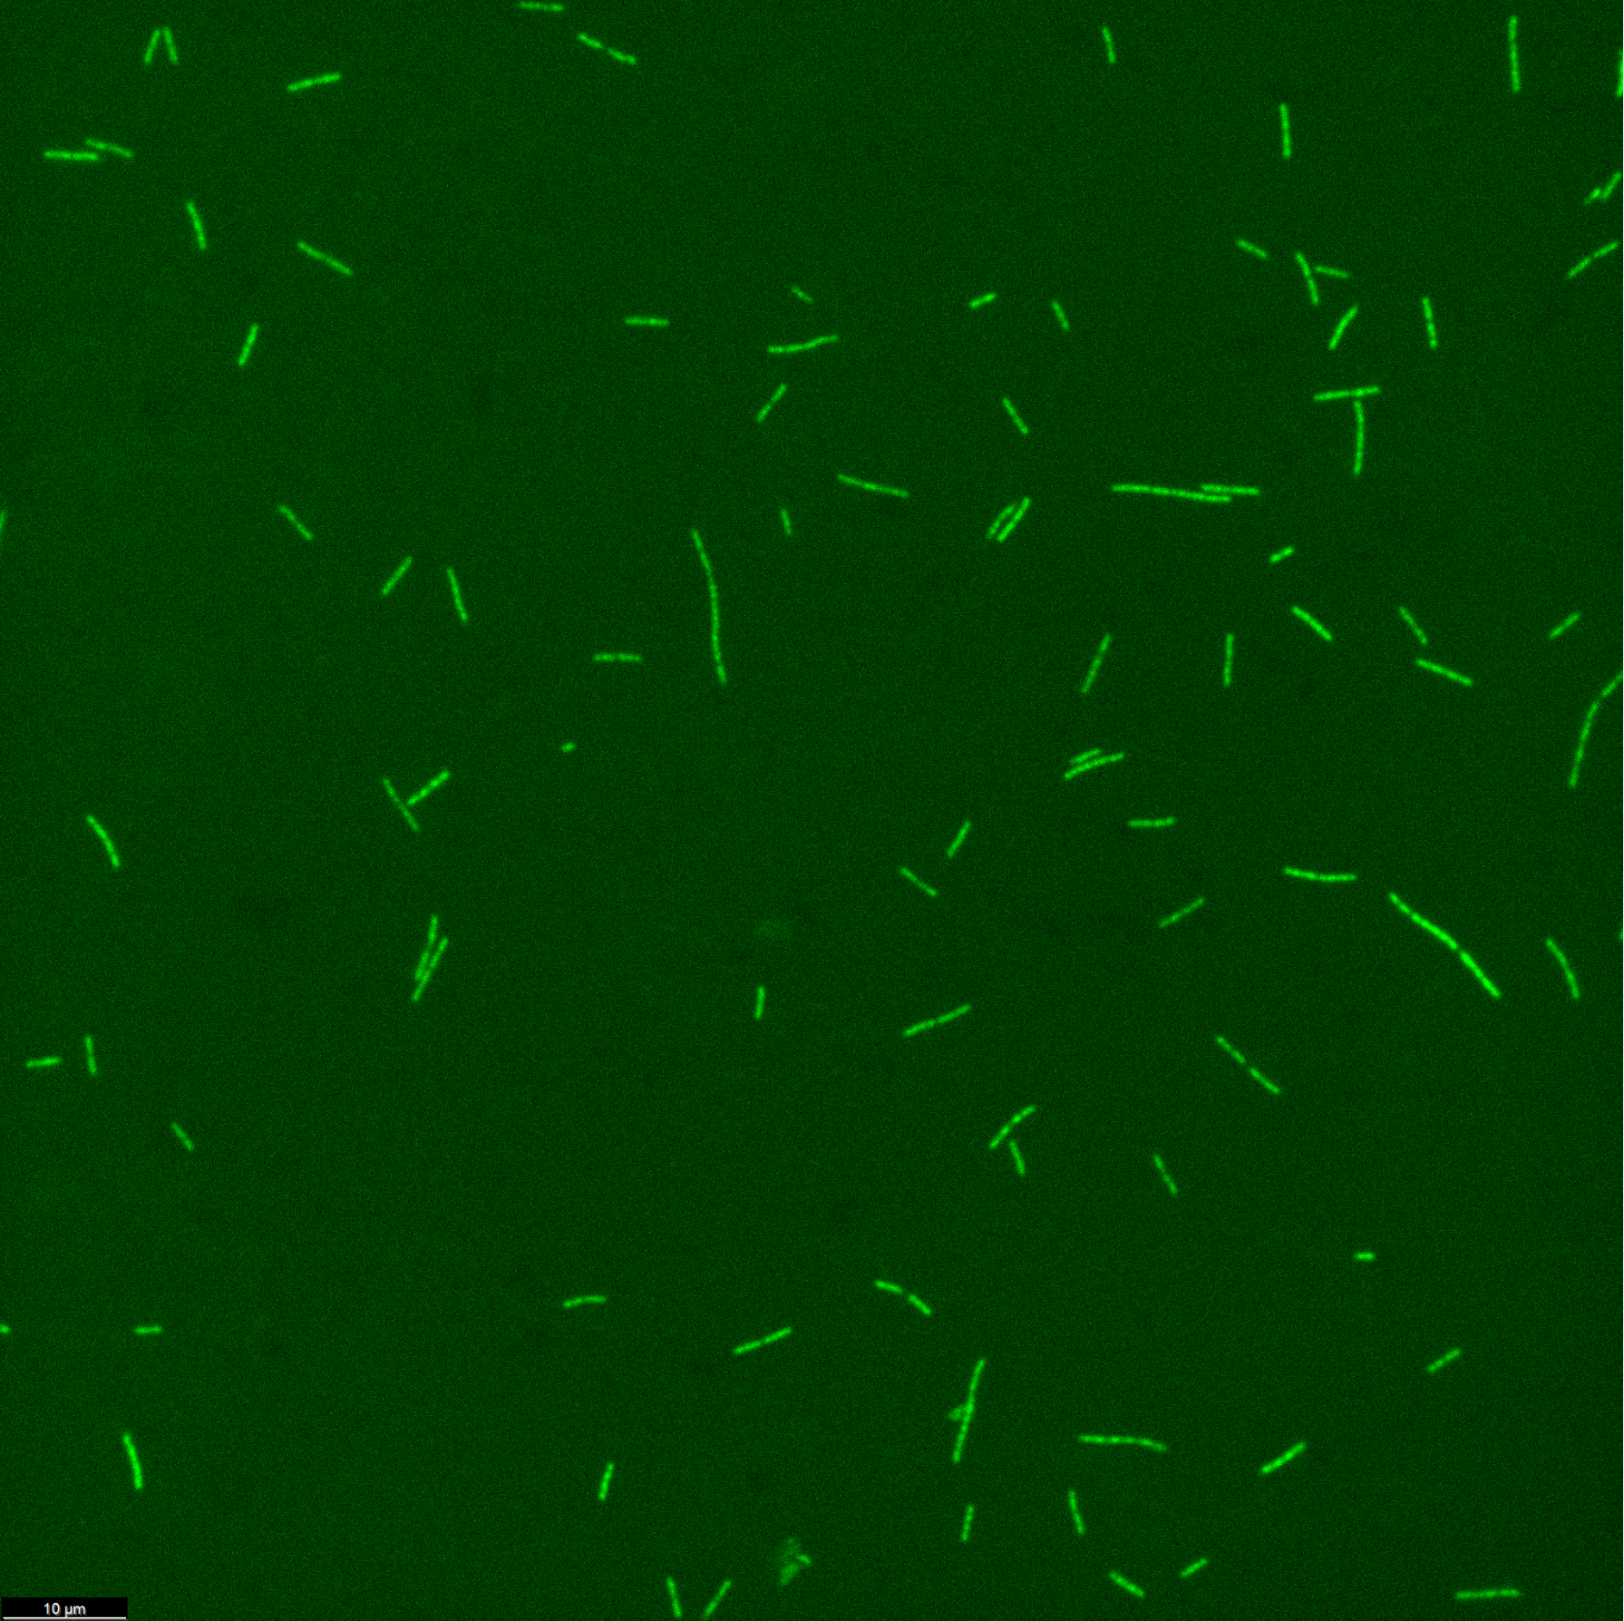
Visual Results - 15C Carbon Ideal
Percent Enrichment of 13C bicarbonate: 0.13%
15C Ideal Early Growth Phase
15C Ideal Late Growth Phase
Notes:
We see that the cells at T2 are much smaller than they were at T0 and T1

Slide 10
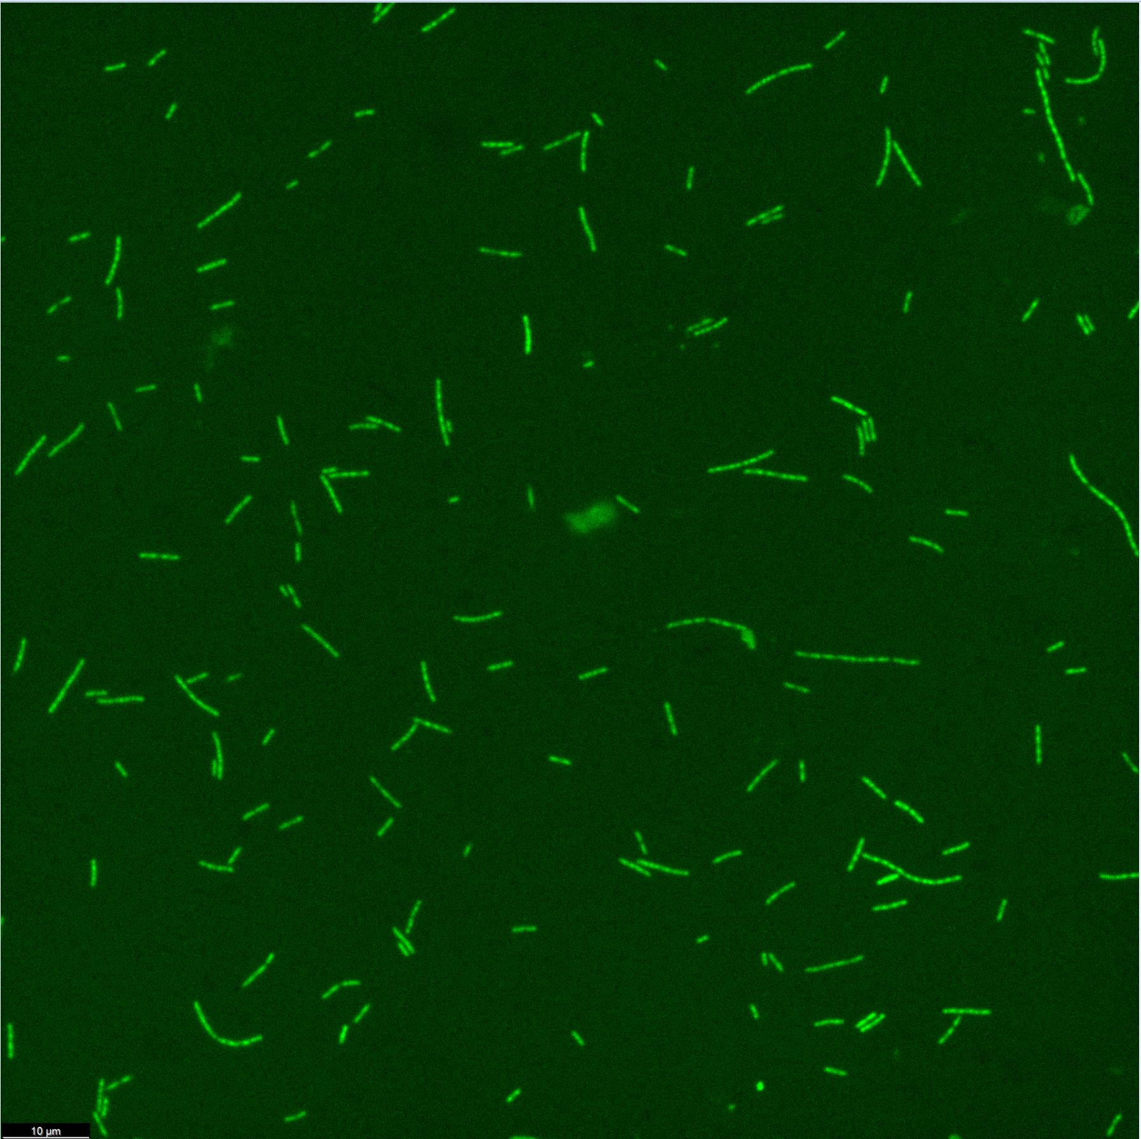
Visual Results - 15C Carbon Limited
Percent Enrichment of 13C bicarbonate: 0.51%
15C Limited Early Growth Phase
15C Limited Late Growth Phase
Notes:
We see that the cells at T2 are much smaller than they were at T0 and T1

Slide 11
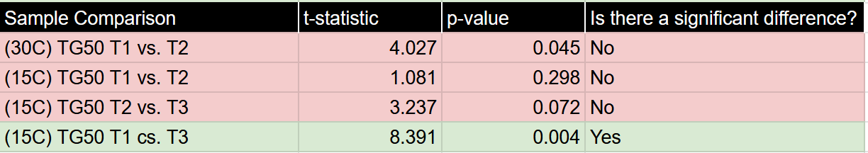
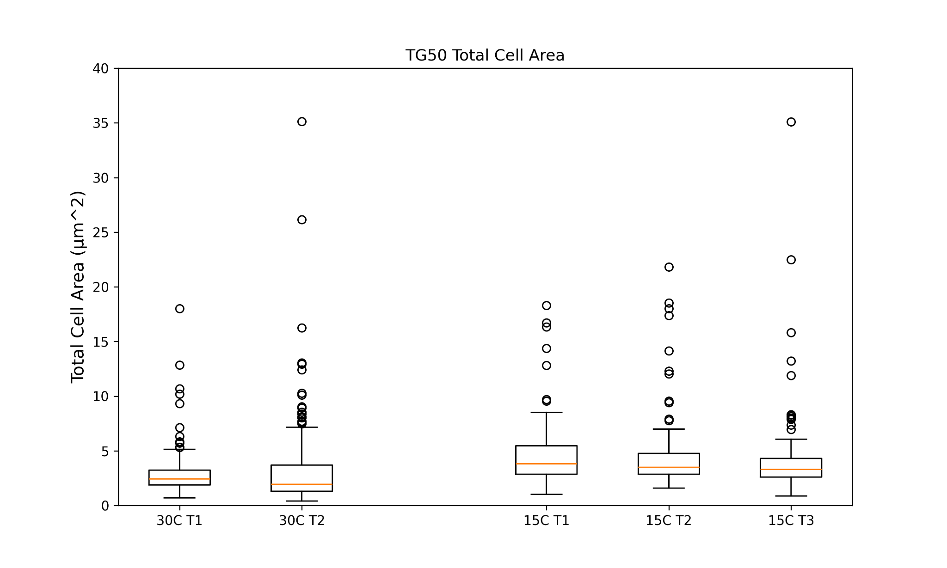
Results - Cell Size, Carbon Ideal (TG50)
At ideal temperature and organic carbon concentration, the sizes of the cells don’t change significantly. However, the range of sizes increases!
At colder temperatures, we see a significant decrease in size, and decrease in the range of sizes.

Slide 12
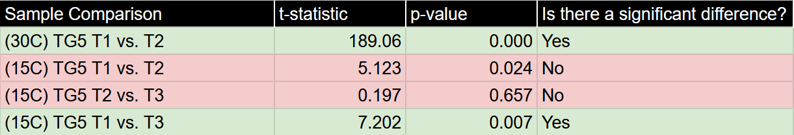
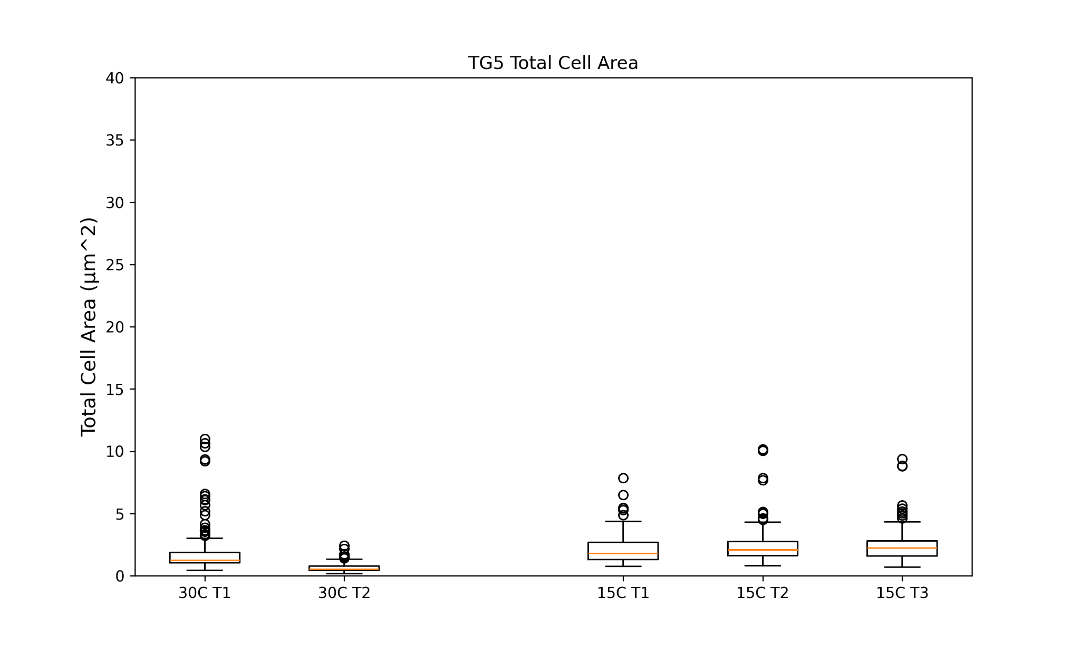
Results - Cell Size, Carbon Limited (TG5)
Significant decrease in cell size and range of size at 30C over time!
At 15C, we don’t see the same decrease in size. Range of size seems to stay constant, and we find a significant increase in median cell size (this may be a statistical error however).

Slide 13
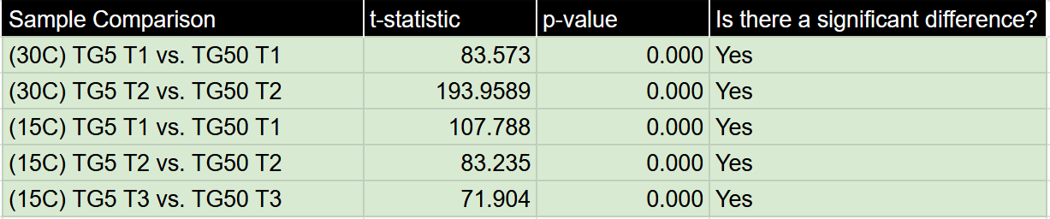
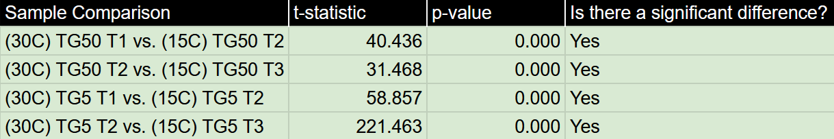
Results - Cell Size Data Comparisons
Carbon Ideal vs. Carbon Limited:
30C vs. 15C:

Slide 14
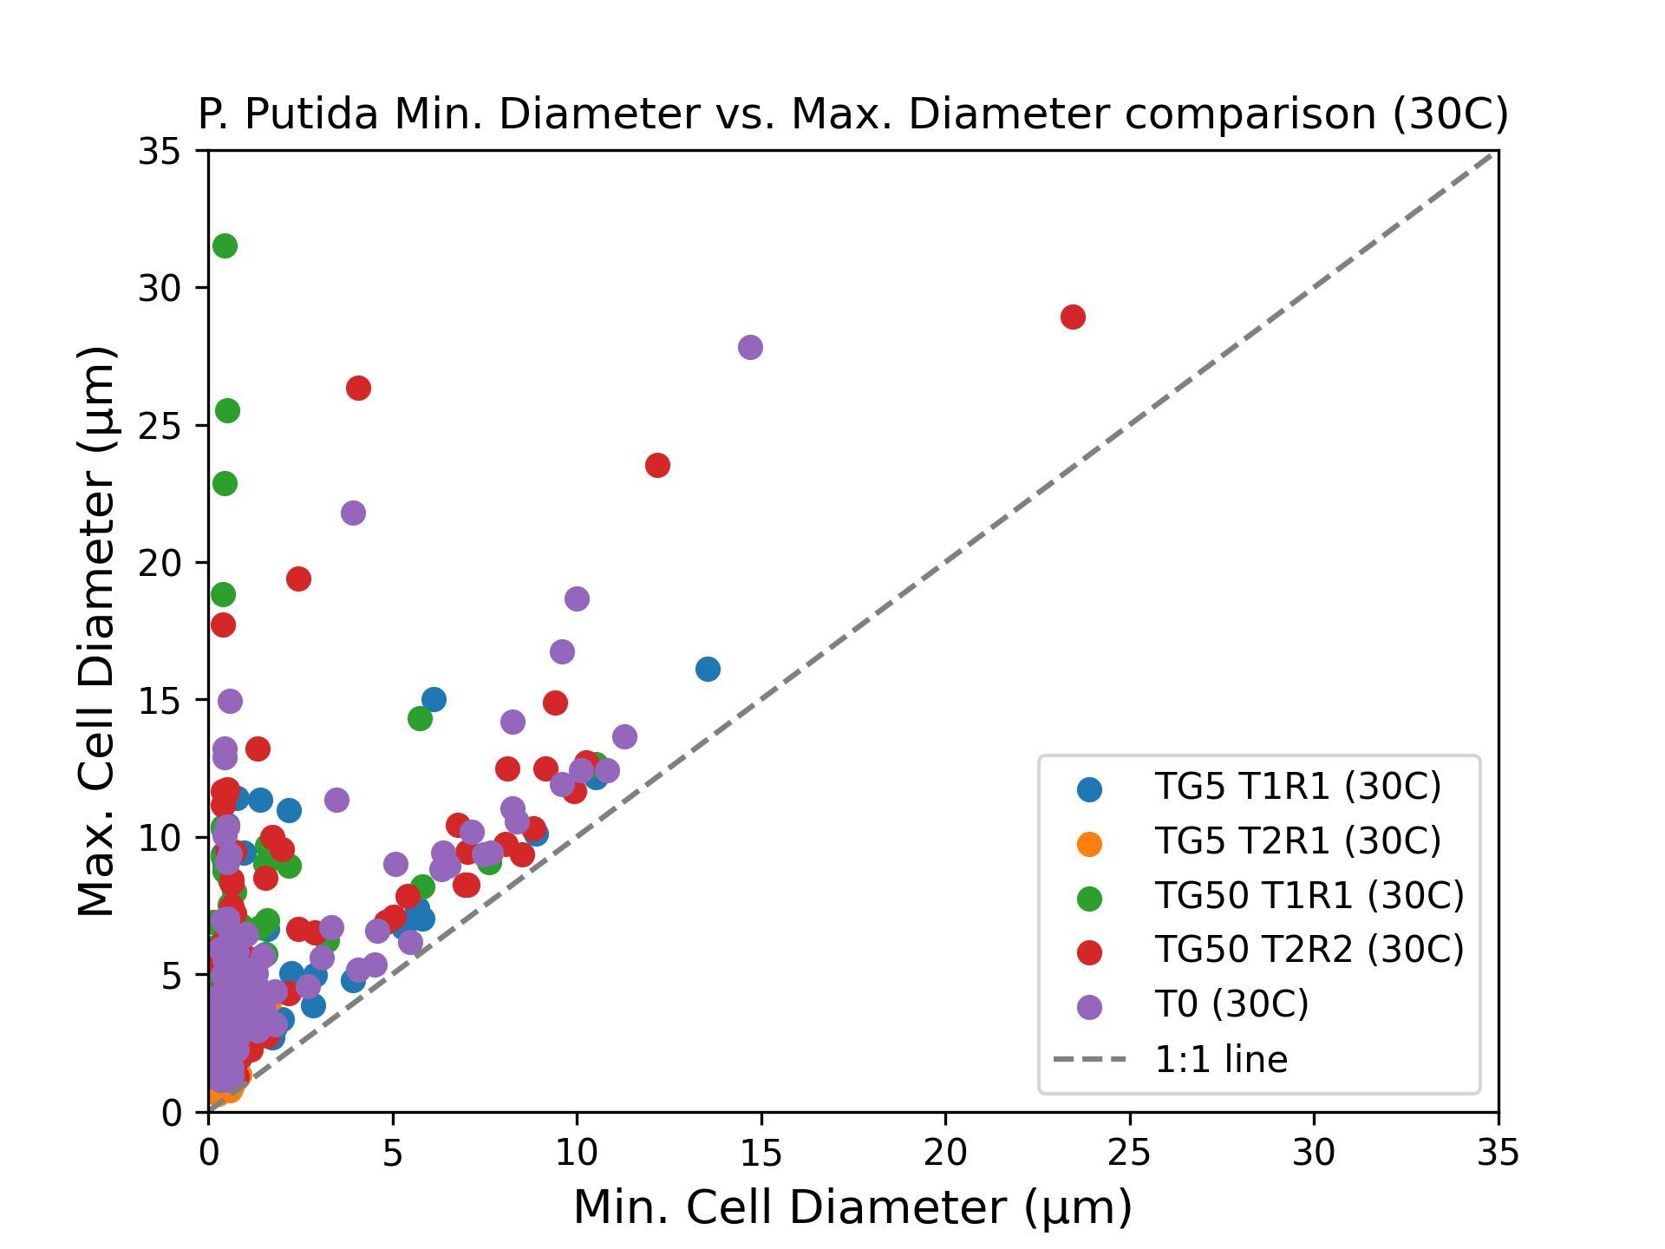
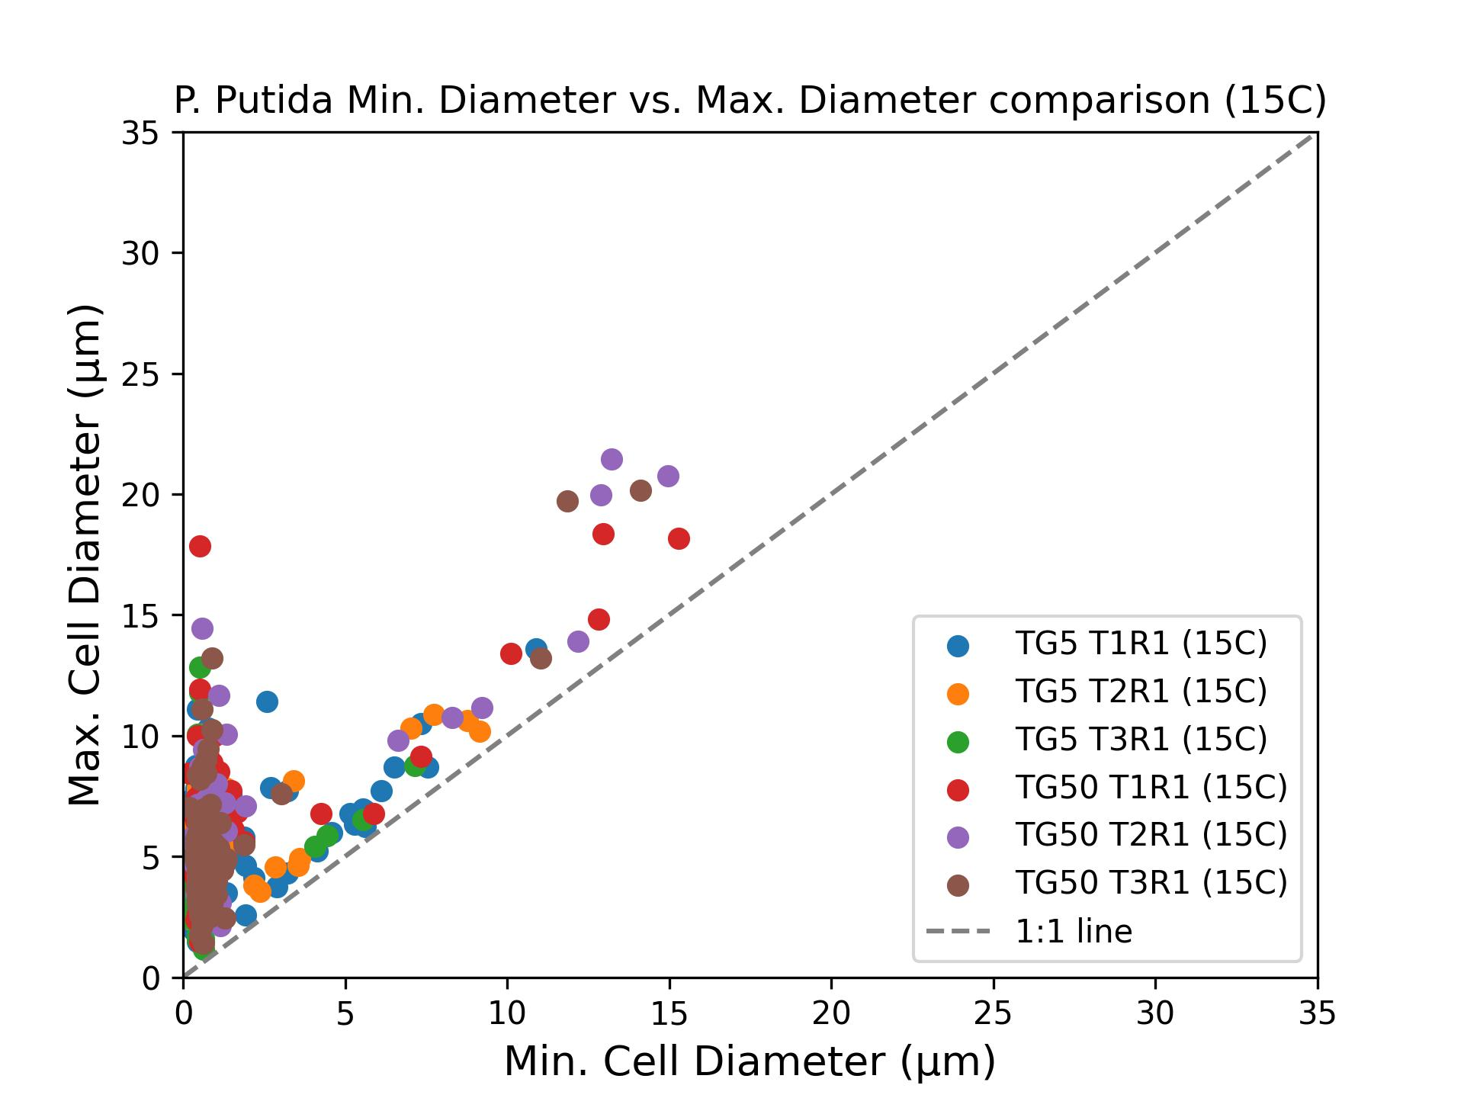
Results - Cell Shape
Across the board, we see cells with long lengths and short widths, and some with more elliptical shapes that ride the 1:1 line.
No obvious trends in cell shape over time, aside from smaller lengths and widths in the carbon limited samples, which we saw when looking at cell size.

Slide 15
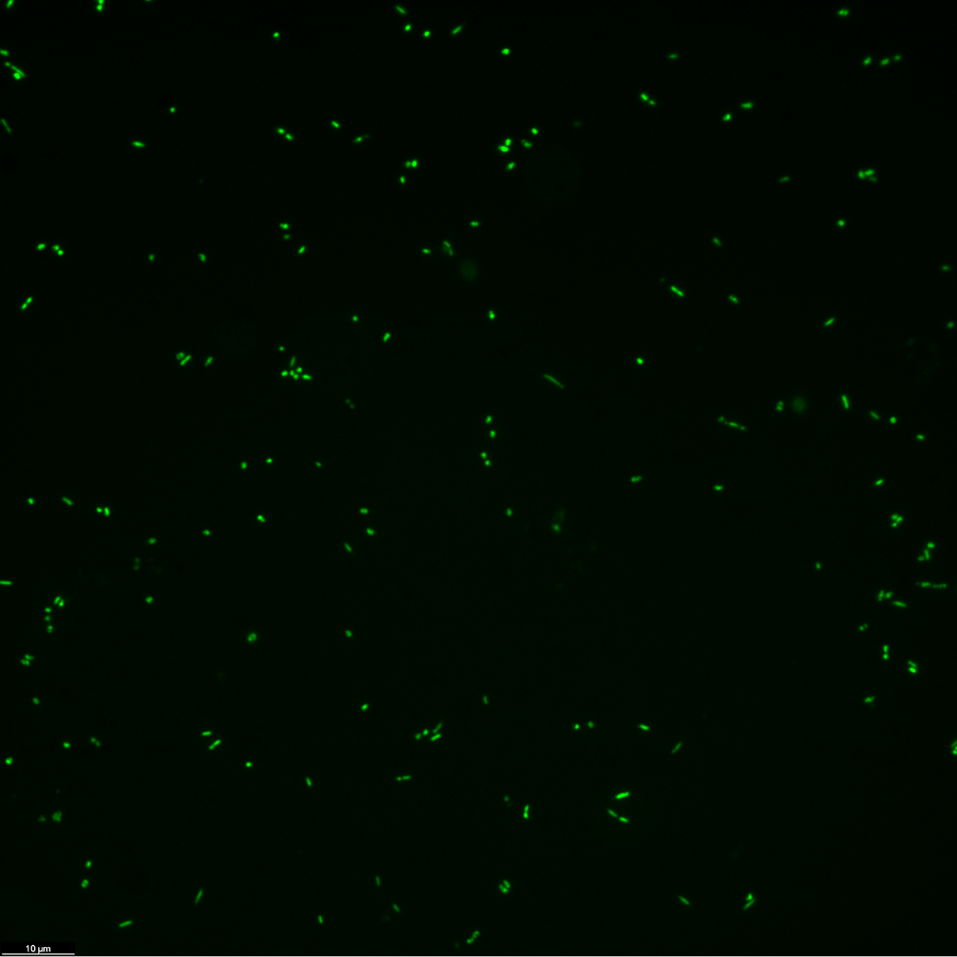
Next Steps
Perform the same methods on a marine microbe species, Pseudoalteromonas carrageenovora.
Future questions to investigate:
Are there universal responses in cell size to changes in nutrient availability?
Do microbes that live in more nutrient scarce environments respond to changes differently than microbes that do not?
A DAIME image of P. carrageenovora.

Slide 16
Thank You!
Any Questions?
Acknowledgements: Arizona Space Grant, Elizabeth Trembath-Reichert, Emma Brown
www.linkedin.com/in/kadin-pulliam-7035b6191

